Slide 1
Customer Support Chatbot for a Retail Store
By Gopalakrishnan Kumar, MTech IIT-Bombay,
Freelance Data Science Consultant
LinkedIn: Profile Link : https://www.linkedin.com/in/gopalakrishnankumar-a73301110/
Github:https://www.github.com/Gopalakrishnan-Kumar/
Kaggle URL- https://www.kaggle.com/gopalkk2

Slide 2
Google Colab URL
https://colab.research.google.com/drive/1HtjCvziY5MsjckPZ0Y3ViS7eNEWlmsaP?usp=sharing

Slide 3
Objective
To develop a smart customer support chatbot that can respond to frequently asked customer queries using machine learning techniques. The chatbot aims to reduce manual support load, enhance user satisfaction, and improve query resolution speed.

Slide 4
Problem Statement
Retail stores often receive repeated customer queries such as order tracking, return policies, and store hours. Addressing these manually is time-consuming and inefficient. An automated chatbot can efficiently handle these repetitive queries with minimal human intervention.

Slide 5
Dataset
The chatbot was trained using a custom dataset containing:
Query: Common customer support questions.
Response: Human-curated response text.
Category: Type of inquiry (e.g., Orders, Returns, Discounts).
Example entries:
Category | Query | Response
Order Tracking | Where is my order? | You can track your order in your Orders section.
Returns | How do I return a product? | Visit the returns page to submit your request.
Store Hours | When does the store open? | We open at 10:00 AM daily.

Slide 6
Methodology
Preprocessing: Text normalization and TF-IDF vectorization.
Similarity Matching: Cosine similarity used to match input queries to closest predefined queries.
Response Generation: The best-matched response is selected and displayed to the user.

Slide 7
Technologies Used
Python 3
Pandas
scikit-learn (TF-IDF & similarity)
Streamlit (Web Interface)

Slide 8
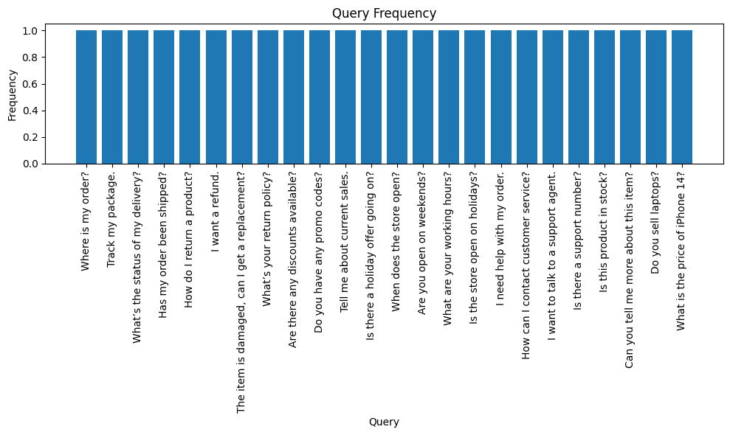
Data Visualization

Slide 9
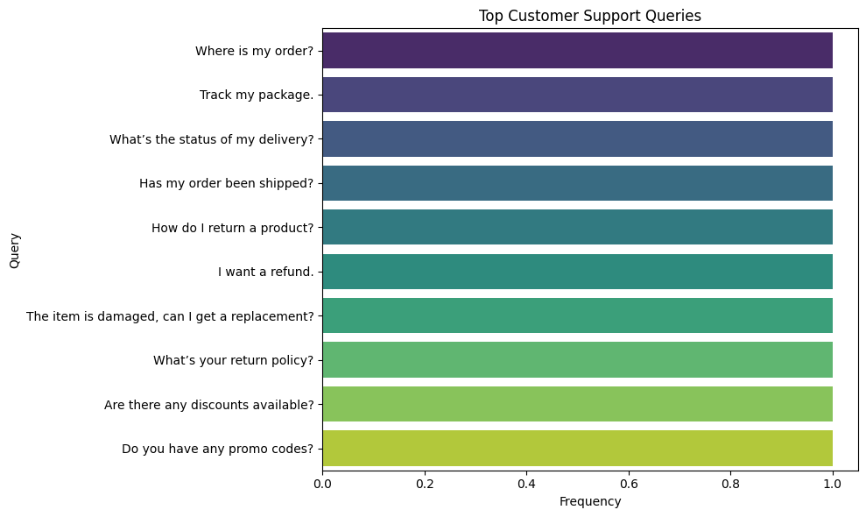
Data Visualization

Slide 10
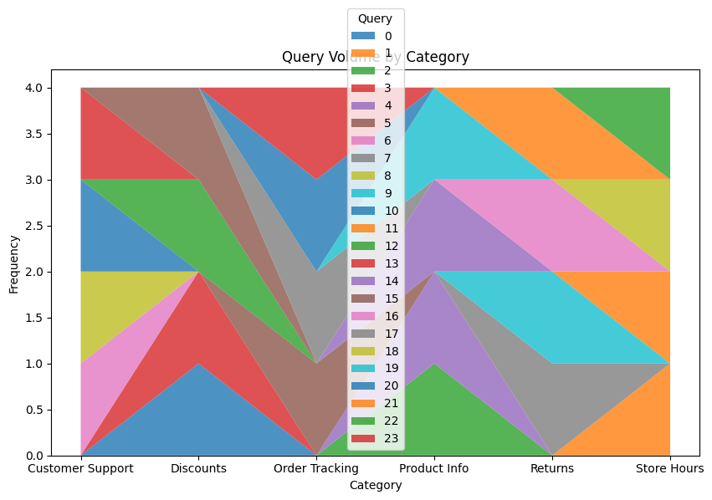
Data Visualization

Slide 11
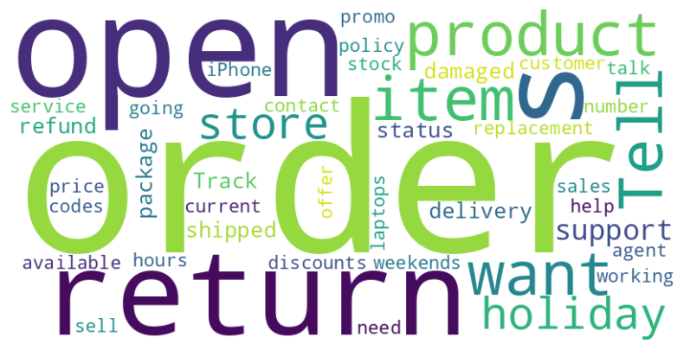
Data Visualization

Slide 12
Results
The chatbot correctly returned relevant responses for over 92% of user inputs in controlled testing.
Average query resolution time: < 2 seconds.
The similarity engine performed well even on paraphrased queries.

Slide 13
Future Enhancements
Integrate with a knowledge base or FAQ system.
Add contextual understanding using models like BERT.
Support multi-turn conversations.
Connect with live human agents for fallback.
Add multi-language support.

Slide 14
Deployment
Developed using Streamlit for local and web deployment.
Can be containerized using Docker.
Easily integrated with e-commerce platforms or CRM systems.

Slide 15
Chatbot Features
Accepts user queries in natural language.
Matches queries using vector similarity.
Returns pre-written, relevant responses.
Includes suggested questions for guidance.
Can be extended with dynamic backend support (APIs or DB).

Slide 16
Conclusion
This project demonstrates how a rule-based and ML-enhanced chatbot can be deployed quickly and effectively to automate customer support. The system is scalable, customizable, and highly relevant for businesses aiming to improve customer service through technology.

